Slide 1
WHAT?
The Spend Reviewer is a collection of python scripts that:
Takes in raw transactional data from two bank accounts and current main credit card.
Applies partial string matches to all my data to give every transaction a “purchase type”.
Summarises spend on each purchase type by month to give me an idea of how much money I’m actually spending on different things.
Notes:
For example, a transaction which description contains the word “Lidl” will be marked as “food and domestic”.
Again, python based.

Slide 2
HOW?
SR_rawdata_tracker.csv
hsbc.py
clyde.py
mands.py
gatekeeper.py
fullmonth_dataset.csv
01_stringmatcher_inputs.csv
stringmatcher.py
02_stringmatcher_uniquevalues_nodescription.csv
reporting.py
ZZ_DATADUMP.csv
ZZ_SUMMARY.csv

Slide 3
Raw DATA TRACKER and account specific scripts
The raw data tracker is used in conjunction with scripts to know what data to pull out to create a complete .csv for each input data source.
Clyde: csvs.
HSBC: csvs.
M&S: pdfs.
Scripts read the raw data tracker, process the data it tells them to, then marks the data as processed in the tracker.
Notes:
Update the raw data tracker with new data to process.
A lot of python.

Slide 4

GATEKEEPER
Runs all the inputs scripts and produces a single .csv of all transactions.
The output .csv is then picked up directly by the string matcher.
Allows for easier changes to inputs scripts without having to then change references in later scripts.
Broadly, more trace-ability when checking errors.
Does mean more .csvs flying around.
Outputs a single .csv of full months of data only.

Slide 5
String Matcher
Takes in a list of partial strings matches that are user defined.
Applies these to each transaction, giving a purchase type for every transaction.
Actually two input csvs, one of which works for transactions with no description, but identified by the amount.
Notes:
Writing all the string matches is mighty time consuming, especially at first.
Regrettably, you’ll never be fully done with it. There’ll always be more strings to match.
Does give a useful summary though of the type of expense.
Does allow you to retrospectively change how partial strings are assigned to see how things look. E.G. maybe McDonalds is “fun” rather than “food_and_domestic”, or vice-versa.

Slide 6
Reporter
Sums transactions to a list of spend by purchase type by month.
Gives a summary of the amount spent on each purchase type in the user-defined period.
A number of data issues still, but together all these values give meaningful insight into where money is being spent.

Slide 7
OUTPUTS
Plots of spend on each purchase type per month.
The total, average, min and max spend on each purchase type over the user-defined period.
Notes:
Lets have a look at the outputs.
A lot of miscellaneous and unassigned.
Enough to still roughly know where money is going.

Slide 8
Spend Reviewer: MAJOR weaknesses
New scripts are needed for every new data type.
Its very difficult to choose partial string matches well.
If input data types change (e.g. M&S change the format of their pdfs), this may require re-writing code.
Notes:
2. Also partial string matching is hierarchical, the last partial string match decides the purchase type in case of a conflict, this makes mistakes even easier.
Purple Aki does not tolerate weakness. Get squatting.

Slide 9
Spend Reviewer: MAJOR STRENGTHS
Huge amounts of data can be processed in almost no time; far faster than any manual tracking.
Purchase types can be changed as wished to see how this affects to total sums.
Summaries and plots are automatically produced.
As this is code based rather than e.g. spreadsheet based, improvements can be quickly run on historic data.
Data can be split up further; e.g. from purchase type -> sub purchase type (e.g. purchase type = ‘fun’, sub purchase type = ‘urethal toys’)

Slide 10
Alternatives
OPTION | MAIN STRENGTHS | MAIN WEAKNESSES
Programmatic Solution such as Spend Reviewer | As discussed. | As discussed.
Keep a track of every transaction as you make it. | Clear visibility of analysis, unlikely to miss things. | Very high effort which in turn increases odds of failing to log a significant number of transactions. Have to also go through direct debits manually to note these too.
Have different account or credit cards for each type of major transaction. | Relatively low effort. | Easy to make mistakes. Requires potentially a large number of cards/accounts.
Notes:
In June 2018, I had 62 transactions. That’s a lot of transactions to manually note.
I have 10 distinct purchase types, after making a lot of effort to reduce to this number. That number of credit cards would be difficult to acquire.

Slide 11
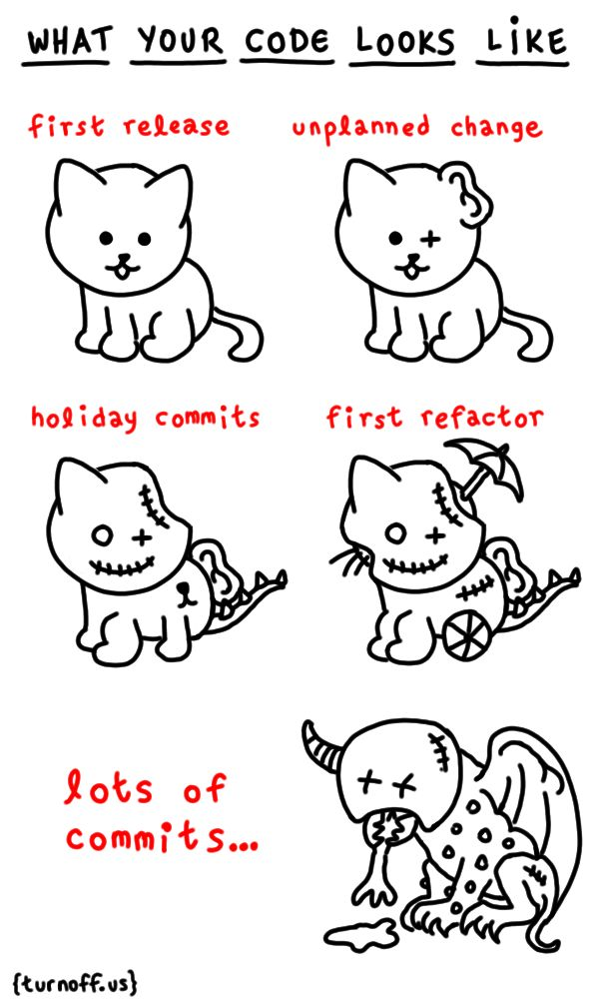
FUTURE DEVELOPMENT
Assign some syntax to my code.
Tidy up with better comments.
Make the graphs clearer/neater.
Tidy up inputs’ and outputs’ names.
Clean up remaining strings to be matched.

Slide 12
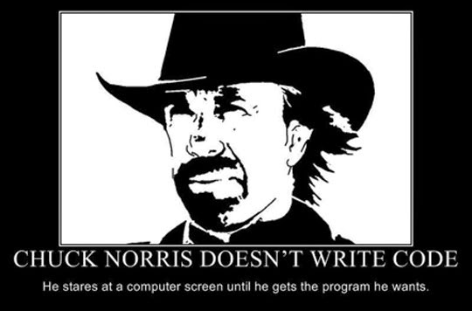
NOTES
Putting on GH so anonymised the transaction data.
Written in version 2 python; need to update.

